Slide 1
Nail your speech! start delivering better presentations today!
OeCD toastmasters club
Mathilde Pak
Michael van den Berg
Toastmasters@oecd.org

Slide 2
Three elements of every speech / presentation
Opening
Body
Closing

Slide 3
Opening your presentation
Attention!
Confidence
Connection

Slide 4
attention
Be surprising!
No platitudes and clichés please!

Slide 5
Connection
Can your relate to that?
Have you been there?
Have you felt that?
Have you done that?

Slide 6
Connection
Keep it conversational
Refer to what you have in common with your audience
Make them move!

Slide 7
CONFIDENCE
Ready...?
1. Relax…
2. Smile…
3. Go!

Slide 8
Our opening today
Imagine, it’s Monday morning, you are going through your inbox… and then it turns out to be your lucky day. You see this email from the organisers of a big international conference. Dear madam…. we would be honoured to welcome you as a keynote speaker. You are asked to deliver a speech in front of a big audience! This is your opportunity to bring the message across! You are excited and nervous. You are going to give a very important and memorable speech!

Slide 9
Our opening today
Imagine, it’s Monday morning, you are going through your inbox… and then it turns out to be your lucky day. You see this email from the organisers of a big international conference. Dear madam…. we would be honoured to welcome you as a keynote speaker. You are asked to deliver a speech in front of a big audience! This is your opportunity to bring the message across! You are excited and nervous. You are going to give a very important and memorable speech!

Slide 10
Our opening today
…
I don’t know whether that already happened to you, but I am sure you have been on the other side, you have been one of the people in the audience. Now think back of the last time you were in the audience in a keynote speech or maybe one of the last times. Be honest, what did you do? By raise of hands: who was checking his email? Who was even writing emails or doing other work?
Yes, that was me!

Slide 11
Our opening today
…
I don’t know whether that already happened to you, but I am sure you have been on the other side, you have been one of the people in the audience. Now think back of the last time you were in the audience in a keynote speech or maybe one of the last times. Be honest, what did you do? By raise of hands: who was checking his email? Who was even writing emails or doing other work?

Slide 12
Our opening today
Bold statement!
The good news is: you can decide to become a better speaker from now on! In order to become an outstanding speaker, you need to practice, but with some simple tips, tricks and tools you can start delivering better presentations as of today!
This is what I am bringing you today!

Slide 13
How about Your opening?
What are the first two sentences you are going to say at your next presentation?

Slide 14
Opening: do’s and don’ts
Do | Don’t
Write it out | Improvise
Make eye contact | Look at the screen / paper
Be surprising | Say obvious and predictable things
Make them laugh | Start with an instant joke
Talk with the audience | Talk to the audience
Use ‘you’ | Say too much ‘I’

Slide 15
The body of your speech
Content
Delivery
Language

Slide 16
The body of your speech
When you are done…
What do you want your audience to take home?
Write it out in one sentence 15 words max.

Slide 17
The body of your speech
Tell stories!
Give data a human face!

Slide 18
Body: ask yourself 3 questions when you have drafted your speech
What is my you/I ratio?
How can I say it better with fewer words?
How can I make it clearer?

Slide 19
Closing
Write it out…
And learn it by heart!

Slide 20
Closing
Wrap up your main points…
Have a clear punchline!
Signal the end

Slide 21
Your closing
What is the last thing you are going to say at your next presentation?

Slide 22
Closing: do’s and don’ts
Do | Don’t
Write it out | Improvise
Signal the end by: | Say:
- Tone of your voice | - “That was it”
- One step back | - “This is the end”
- Punchline | - “Are there any questions?”
 | Stop abruptly

Slide 23
You were already awesome, but from now on, you are a better speaker!
1. Save the hand-out (we will send it to you)
2. Use it next time you draft a speech, check the DO’s and DON’T’s
3. Practice! Write it out, time it, rehearse
4. And enjoy it!

Slide 24
Oh, and one more thing!
LEARN THE RULES LIKE A PRO, SO YOU CAN BREAK THEM AS AN ARTIST (Picasso)

Slide 25
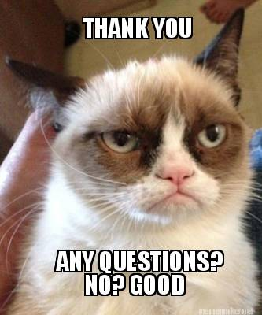

Slide 26
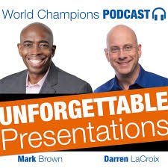
Want to learn more? Contact us!
A big thank you to all our fellow Toastmasters inside and outside OECD!
Toastmasters@oecd.org
or contact your local Toastmaster!

